Slide 1
Design for Mobile Empowerment in
South African Education
PDC
Windhoek, Namibia
5 Oct 2014

Slide 2
The paper develops Capability Sensitive Design method and captures participation:
Data gathering phase
Pluralistic analysis by use of Capability Approach
Empathy stage of Design Thinking

Slide 3
Mobile Empowerment
Empowerment : intersection of agency and existing opportunity structures; where agency consists of the capacity of individuals to make meaningful choices, measured by endowments of psychological, informational, organizational, material, social, financial and human assets.
Wicked problem: balancing individuals’ need to believe they can cope adequately with events, situations, and/or people confronting them; with organizational objectives such as transparency, governance and accountability.

Slide 4
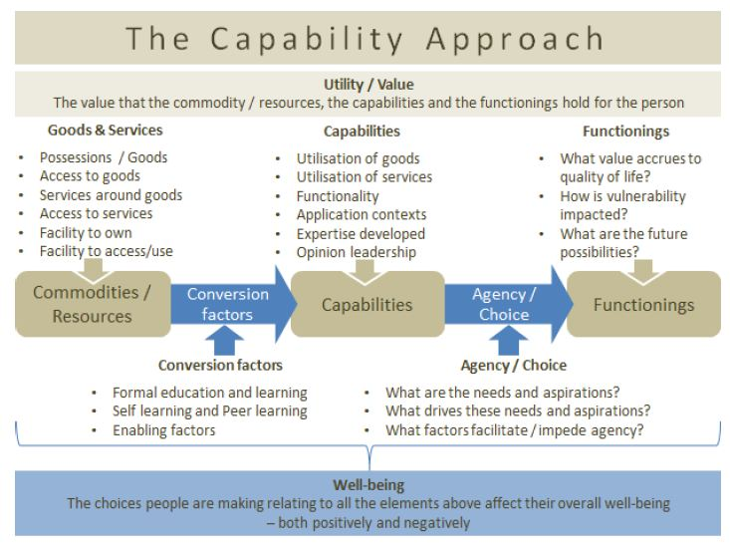
CA for Human Development and Empowerment
Shift from neo-classical economics and market liberalism to pluralist human development
Capability: freedom to achieve functionings people have reason to value
    Political freedom
    Economic facilities
    Social opportunities
    Transparency guarantees Protective security
ICT4D: technology as capability extension
(Prinsloo et al., 2012)

Slide 5
CA Strengths and Weaknesses
Strengths
Human-centred understanding of development
Complex notion of freedom. Choice.
Empowerment and participation key in constructing the rational subjectivity needed for exercising choice.
Relevance of choices, relative to values held by individuals, is assured through processes of participation.
  “Degrees of empowerment”
    (Alsop & Heinsohn, 2005; Kleine et al., 2012)
    Empowerment: intersection of agency (i.e. “the capacity to make meaningful choices”) and existing opportunity structures
Weaknesses
(Heeks & Molla, 2009; Zheng & Stahl, 2011)
Emphasis on rationality, cerebral, over-analytical
Assumed individual autonomy and agency. Reluctance to theorize how it may be restricted.
Overlooks embedded aspects of human values and choice
Emphasis on empowerment individualizes poverty and depoliticizes inequality
Technology as value-neutral resource. Simplistic view of technology.
Applications require interpretation

Slide 6
DT for Industrial Change and Innovation
Industrial shift mandates improved innovation process:
    Fluid organizational structures
    Economy of signs and meanings
    Product saturation
Design: discipline with “fragmented core”:
    Move away from primary concern with materiality
    Shift from normative discourse about optimality, esthetics; to an embedded practice of research-in-action
    Discipline transcended origins as an artistic, studio-based practice and moved firmly into managerial practice

Slide 7
DT Strengths and Weaknesses
Strengths
Frames organizational problems as design problems
    (Brown & Wyatt, 2010; Brown, 2008; Plattner, Meinel, & Leifer, 2010)
Enables managers to balance resource demands of creative exploration with benefits to bottom line
Embodiment and being-in-the-world as key conditions for knowing-in-action and transforming practice
De-politicized critique of managerial practice and process-oriented approach for addressing that critique
Curbs over-reliance on analysis
Weaknesses
Fails to reference wider theories of the social
Misses opportunities to capture fully context where the designer is intervening
Although empathy with users is fundamental within DT, designer/researcher is often framed as agent of change
    outdated perception within social sciences

Slide 8

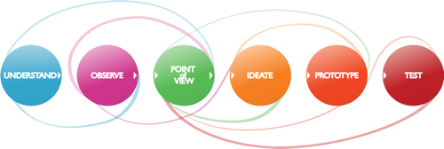
Design Thinking Process
Innovation consultancies: IDEO, Intuit, etc.
d.school, Stanford University, CA
D-School, HPI, Potsdam, Germany

Slide 9
Hybrid Approach: Capability-Sensitive Design
Design Thinking is about the creation of, as well as adaptive use of a body-of-behaviours and values. This goal stands in sharp contrast to, while complimentary to, the predominant disciplinary model based on the creation and validation of a body-of-knowledge. (Plattner et al., 2010)
as a body of research behaviours for innovation, DT can be aligned with the body-of-knowledge derived through the CA
CA can serve as a useful framework for scoping out the problem space for the design of transformative ICTs.
DT operationalizes the translation of the problem space into the solution space
iterative alignment of both spaces
Hybrid approach develops understanding of empowerment and choice by combining the strengths of CA and DT

Slide 10
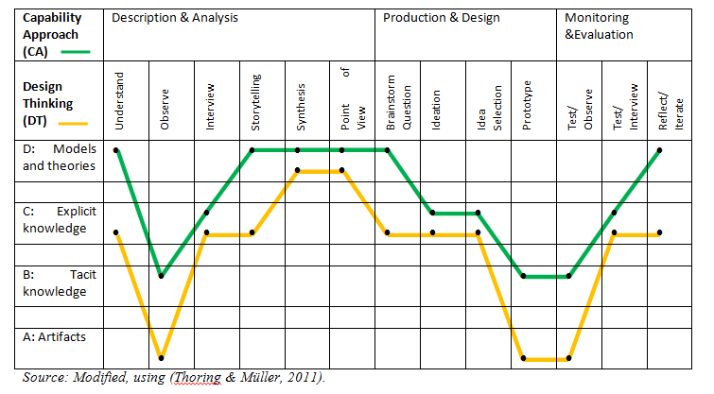
Knowledge in Design Thinking
(Thoring and Muller, 2011)

Slide 11
POV Syntax
[USER] needs to
[USER NEED] because
[SURPRISING INSIGHT]
A teenage girl needs more nutritious food because vitamins are vital to good health.
A teenage girl with a bleak outlook needs to feel socially accepted when eating healthy food, because to her a social risk is more dangerous than a health risk.
[a user group] [needs a technology] because [insight into constraints to the group’s agency and the dynamics of their choice to exercise capabilities].

Slide 12
Design Concept
Challenge, Principal Persona, Class Journal, Solution

Slide 13
Project Description
The aim of the project is to demonstrate the viability of the delivery of e-government services via public cloud architectures, using the ICT4RED initiative
Public Cloud 4RED
SAP
Provides software services
Public Cloud
Provides hardware infrastructure
ICT4RED
Facilitates access
Meraka
DST
CHPC
DBE

Slide 14
The Challenge
Bringing ICTs into schools affects profoundly the teaching and learning environment. Tablets are powerful multimedia devices and can be used in a myriad of ways to support education.
How can school principals ensure they take full advantage of technology investment?
  How can school principals monitor use of tablets in the classroom?
  What process changes in teaching and learning can be captured via context aware services?

Slide 15
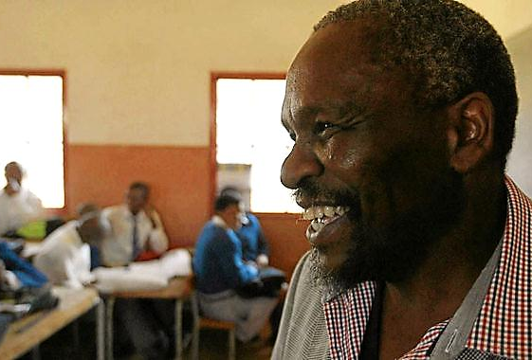

School Principal
Mr Jackson is school principal in Cofimvaba district. He values learner performance at national examinations. He is looking to understand how the introduction of tablets within the classroom setting, changes user experiences of teaching and learning. He wants to know:
Are teachers and learners bringing their devices to the classroom?
How do the devices enable teachers to teach better?
How do the devices empower teachers to teach differently?
How do the devices fit in existing school model?
Mr Jackson wants evidence of school-based interactions:
  In-person (attendance, classroom interactions)
  Digital (with people online and digital resources)
  Hybrid (ad-hoc classroom interactions)

Slide 16
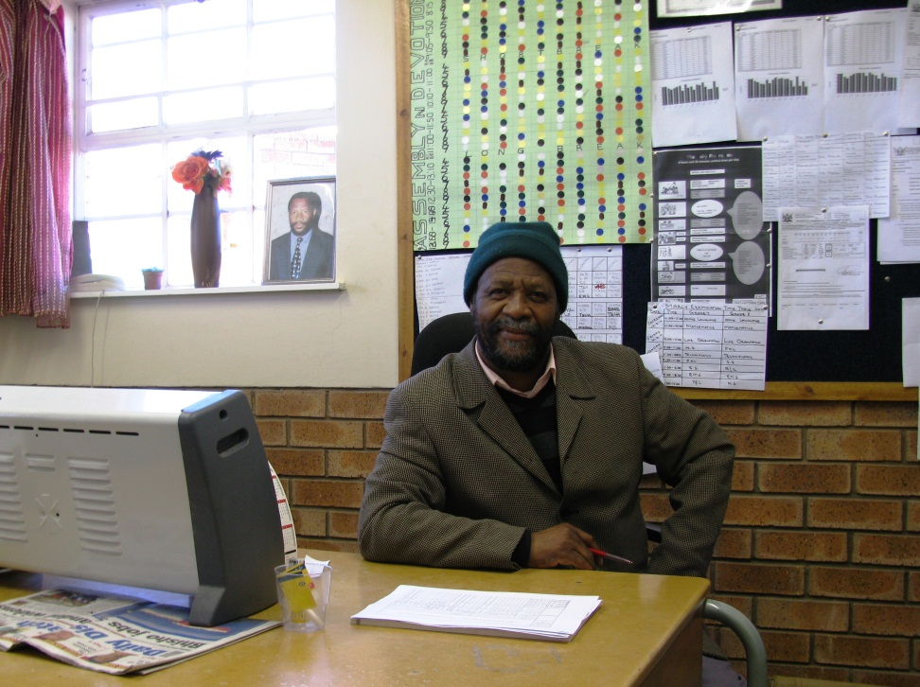

Simphiwe Chulayo
Observations
  Paper school timetable
  Printouts
  Heater/ hat
  Trained teachers, equipped with tablets
Challenges
  15 tablets to be shared
  Only 5 teachers use tablets voluntarily
  After July compulsory use in intermediary and senior phase (4-5-6-7-8-9) i.e. 6 classrooms

Slide 17




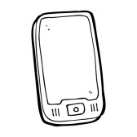
‘Class Journal’ Concept
21st century classroom register
Student-centred classroom management
Record interactions
    people
    content
    hybrid
  My Journal (OLPC)
  Teacher Kit ( for iPads)
  BeHere (for iBeacons)

Slide 18
‘Class Journal’ Functionality
In-person interactions
Hybrid interactions
Attendance. Seamless head count or confirmation by the teacher
Physical activity levels (e.g. number of steps by teacher)
Classroom environment (e.g. heat, light, noise)
Requests for help, and responses
Form ad-hoc groups
Homework assignments
Push content to students in the classroom
Teacher manages Beacon?
Digital Interactions
Dashboard
Tablet/ application use
Document work (e.g. lesson plans)
  Guiding teachers toward earning more badges: ‘teachers with 2 badges also did this’
  ‘Flipped classrooms’, ‘Game-based learning
Interactivity metrics
    In-person
    Digital
    Hybrid

Slide 19
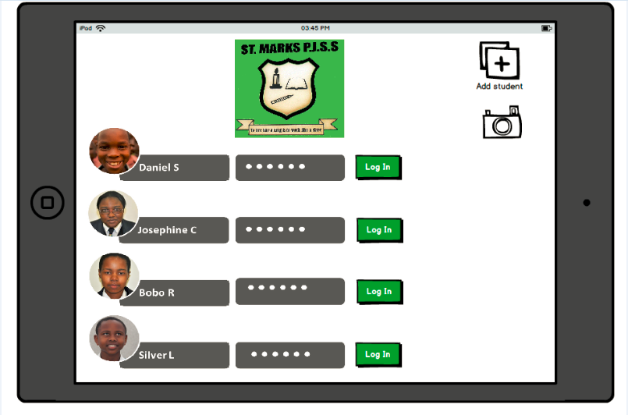
Log in screen

Slide 20
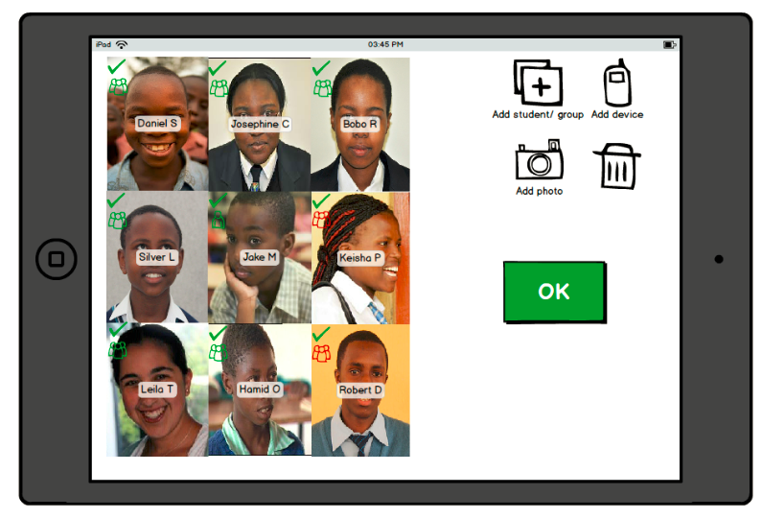
Learners in Attendance

Slide 21
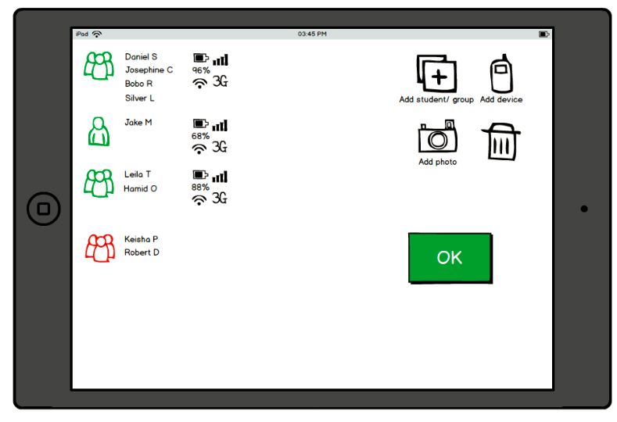
Devices in the Classroom

Slide 22
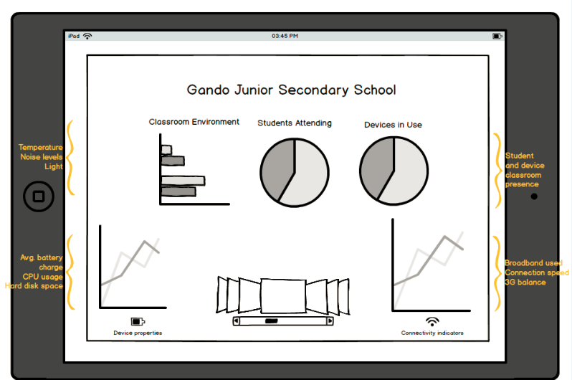
School Principal/ Circuit Dashboard

